Slide 1
PDAT613G: Data Mining
Module 2B - Unsupervised Learning

Slide 2
00 - Unsupervised Learning
Supervised Learning—Regression, Trees/Forests, Support Vector Machines
Works great when it works.
What happens when no “right answer” is provided?
Instead, can we just explore to see which observations are most like others? Can we find ways to simplify our dataset to eliminate redundant items or to combine items into a smaller number of important factors?
Unsupervised Learning:
Clusters (KMeans, Hierarchical) - Identify homogeneous groups.
Dimension Reduction - Combine variables into important factors.

Slide 3
Clustering

Slide 4
01 - Cluster Analysis
Cluster: a collection that is made up of similar observations.
Cluster analysis: an unsupervised learning method that starts with a large number of observations.
Clustering algorithms: classify objects in multiple groups, such that objects within the same cluster are as similar as possible, while objects from different clusters are as dissimilar as possible.
Two types of clustering are most common:
K-Means Clustering creates the number of groups that you ask for.
Hierarchical Clustering makes a tree or dendrogram that makes as many or as few clusters as you want.

Slide 5

02 - Practical Application of Clustering: Google News

Slide 6
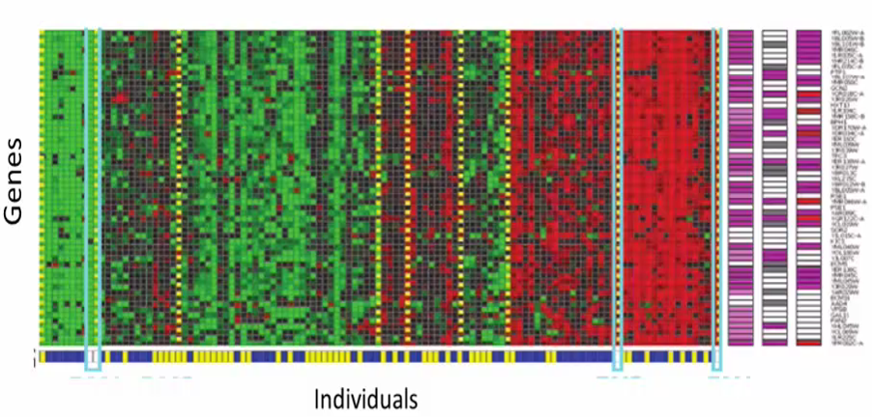
03 - Cluster Analysis - Genetic Similarity

Slide 7
04 - Clustering Can be Used in Many Areas
Systematic Biology: Where do seals fit in the evolutionary tree?
Bank/Internet security: fraud/spam pattern discovery.
Image compression/segmentation: coherent pixels grouped.
Climate: Regions with similar growing seasons?
City-planning: Identifying groups of houses according to their house type, value, and geographical location.
Marketing: Recognize meaningful customer groups that might respond favorably to different kinds of marketing or incentive programs.

Slide 8
K-Means Clustering

Slide 9
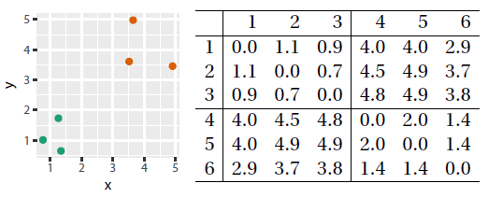
05 - K-Means Clustering
K-means clustering splits observations into a fixed number (k) of clusters.
In k-means clustering, each cluster is represented by its centroid, which is just the mean of points across all of your important variables. In one or two dimensions this is easy to see where the centroid is. In more complicated datasets, it is harder to visualize, but just as easy to calculate.
In this small example, it is easy to see how the green points and the orange points form two clusters, even without looking at the included distance matrix between each pair of points.
Clusters are designed to minimize the “distance” among their points.

Slide 10
06 - K-Means Algorithm
We specify the number of clusters (k) to be created.
The algorithm randomly selects k observations from the data set to serve as the initial cluster centroids (knowing they probably aren’t very good).
The algorithm assigns each observation to their closest group, based on finding the shortest distance between the observation and each centroid.
The algorithm then calculates the mean values for each resulting cluster to identify the new centroid for each cluster. This centroid is probably not an actual observation, but falls somewhere in the middle. The centroid of a cluster is literally a vector p containing the means of all variables for the observations in that cluster.
The computer then repeats steps 3 and 4 until either
the clusters quit moving, or
a given number of steps has been completed.
(R uses 10 as the default value for the maximum number of iterations.)

Slide 11

07 - K-Means Algorithm - Visualization from YouTube

Slide 12
08 - K Means Implementation in R
We can compute k-means in R with the kmeans function. The output of kmeans is a list with several bits of information. The most important are the following:
cluster: A vector of integers (from 1 to k) indicating the cluster to which each point is allocated.
centers/centroids: A matrix of cluster centers.
The other outputs include:
totss: The total sum of squares.
withinss: Vector of within-cluster sum of squares, one component per cluster.
tot.withinss: Total within-cluster sum of squares, i.e. sum(withinss).
betweenss: The between-cluster sum of squares, i.e. totss – tot.withinss.
size: The number of points in each cluster.
There is also a cluster package in R that does a variety of fancier kinds of clustering and includes additional tools for clusters. If you are going to use clustering a lot in the future, this package is worth exploring, even though this class is just using the base-R command.

Slide 13
09 - K-Means Implementation in R - IRIS Data set
# load the iris data set data(iris) # view the first few rows of the data set head(iris)
Sepal.Length Sepal.Width Petal.Length Petal.Width Species 1 5.1 3.5 1.4 0.2 setosa 2 4.9 3.0 1.4 0.2 setosa 3 4.7 3.2 1.3 0.2 setosa 4 4.6 3.1 1.5 0.2 setosa 5 5.0 3.6 1.4 0.2 setosa 6 5.4 3.9 1.7 0.4 setosa

Slide 14
10 - K-Means Implementation in R - IRIS Data set
x <- iris[1:4] # segregate the independent variables y <- iris$Species # segregate the dependent variable # run the K-means algorithm and divide the data set into 3 clusters k_means_fit <- kmeans(x,3) # compare the results with the true labels table(y,k_means_fit$cluster)
y 1 2 3 setosa 50 0 0 versicolor 0 48 2 virginica 0 14 36

Slide 15
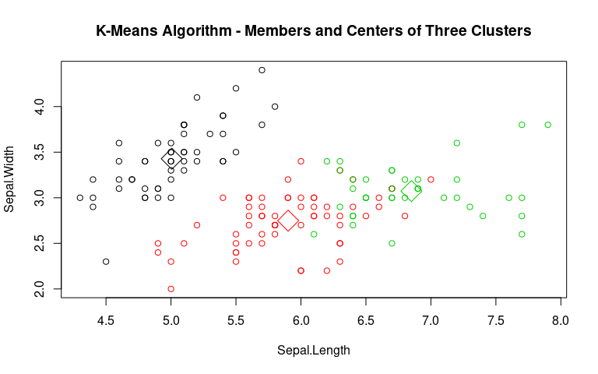
11 - K-Means Implementation in R - IRIS Data set Output
# plot the clusters with their centroids plot(x[c("Sepal.Length", "Sepal.Width")], col=k_means_fit$cluster, main = "K-Means Algorithm - Members and Centers of Three Clusters") points(k_means_fit$centers[,c("Sepal.Length", "Sepal.Width")], col=1:3, pch=23, cex=3)

Slide 16
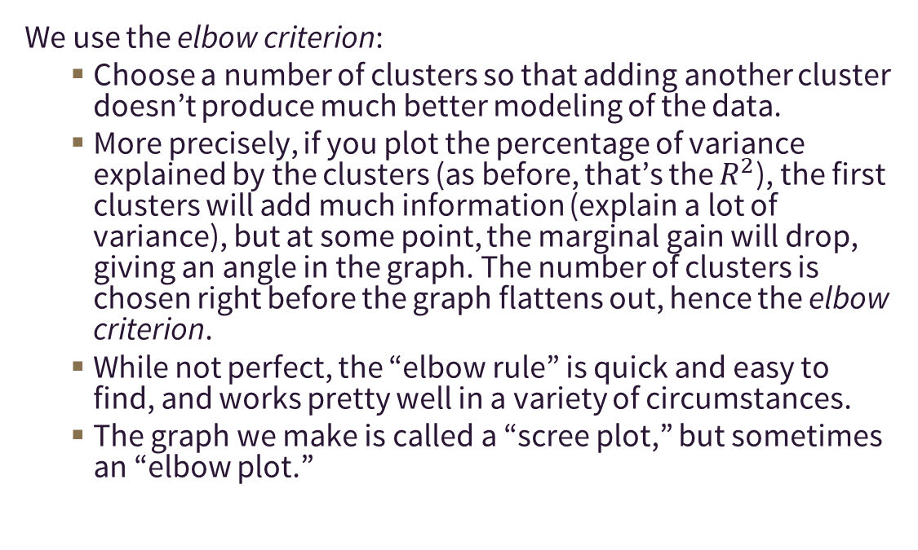
12 - How to Determine How Many Clusters
We use the elbow criterion:
Choose a number of clusters so that adding another cluster doesn’t produce much better modeling of the data.
More precisely, if you plot the percentage of variance explained by the clusters (as before, that’s the $R^{2}$), the first clusters will add much information (explain a lot of variance), but at some point, the marginal gain will drop, giving an angle in the graph. The number of clusters is chosen right before the graph flattens out, hence the elbow criterion.
While not perfect, the “elbow rule” is quick and easy to find, and works pretty well in a variety of circumstances.
The graph we make is called a “scree plot,” but sometimes an “elbow plot.”

Slide 17
13 - K-Means in R - Elbow Plot Code
wssplot <- function(data, nc=15, seed=1234){ wss <- (nrow(data)-1) * sum(apply(data,2,var)) for (i in 2:nc){ set.seed(seed) wss[i] <- sum(kmeans(data, centers=i)$withinss)} plot(1:nc, wss, type="b", xlab="Number of Clusters", ylab="Within groups sum of squares")} # Let us try to plot the "elbow plot" for n = 10 clusters. wssplot(x, nc=10)

Slide 18
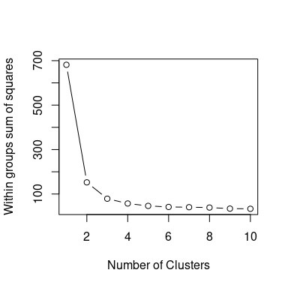
14 - K-Means in R - Elbow Plot
Based on the plot, you can see that the amount of variance explained by the model does not increase significantly after n = 3 clusters, hence we need to select the number of clusters as 3.

Slide 19
Hierarchical Clustering

Slide 20
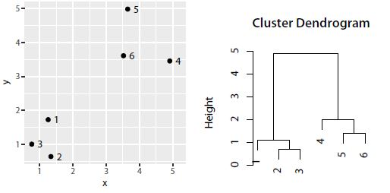
15 - Hierarchical Clustering
Hierarchical clustering takes a different approach to clustering.
Instead of specifying the number of clusters at the start, we instead cluster observations that are most similar near each other, while those that are different are placed further away. This similarity can be thought of as a “distance” measure.
Hierarchical clustering naturally produces dendrograms, which are tree-based representations.
To recognize a particular number of clusters, one can return to the dendrogram and “slice” the tree to generate the desired number of clusters.

Slide 21
16 - Hierarchical Clustering Algorithms
Agglomerative clustering: Also known as AGNES (Agglomerative Nesting). It works in a bottom-up manner. That is, each object is initially considered as a single-element cluster (leaf). At each step of the algorithm, the two clusters that are the most similar are combined into a new bigger cluster (nodes). This procedure is repeated until all points are members of just one single big cluster (root). The result is a tree which can be plotted as a dendrogram (tree).
Divisive hierarchical clustering: It’s also known as DIANA (Divise Analysis) and it works in a top-down manner. The algorithm is an inverse order of AGNES. It begins with the root, in which all objects are included in a single cluster. At each step of the iteration, the most heterogeneous cluster is divided into two. The process is repeated until all objects are in their own cluster.
Both kinds are in base-R, in the cluster package, and others as well.

Slide 22
17 - Hierarchical Clustering R Code
data(iris) # load the iris data set x <- iris[1:4] # segregate the independent variables y <- iris$Species # segregate the dependent variable d <- dist(x, method = "euclidean") # Dissimilarity matrix hc1 <- hclust(d, method = "complete" ) # Hierarchical clustering using # complete linkage sub_grp <- cutree(hc1, k = 3) # Cut tree into 3 groups or at level 3 table(y, sub_grp) # Number of members in each cluster
sub_grp y 1 2 3 setosa 50 0 0 versicolor 0 23 27 virginica 0 49 1

Slide 23
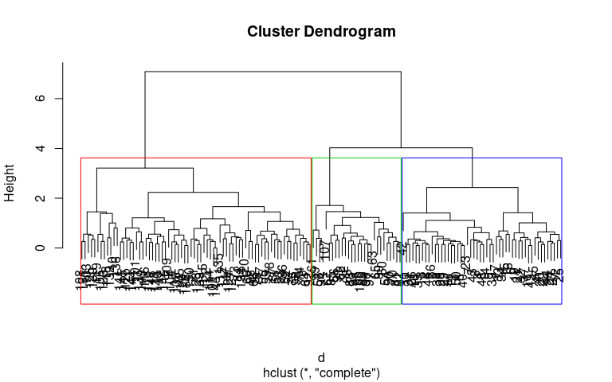
18 - Hierarchical Clustering R Code
# Plot the obtained dendrogram plot(hc1) rect.hclust(hc1, k = 3, border = 2:4)

Slide 24
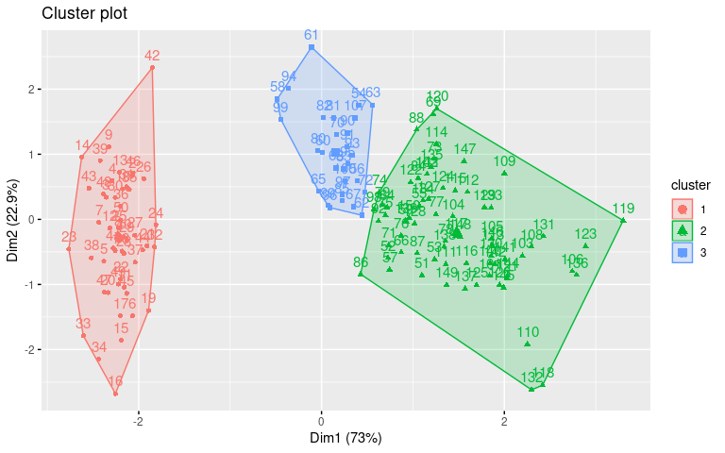
19 - Hierarchical Clustering Output
#Showcase the visualization library(factoextra) fviz_cluster(list(data = x, cluster = sub_grp))

Slide 25
20 - Question
Which of the following statements is true?
For k-means clustering you need to decide the number of clusters before running the algorithm, while for hierarchical, you do not.
For hierarchical clustering you need to decide the number of clusters before running the algorithm, while for k-means, you do not.
For k-means and hierarchical clustering methods you need to decide the number of clusters before running the algorithm.
For k-means and hierarchical clustering methods you do not need to decide the number of clusters before running the algorithm.

Slide 26
Dimension Reduction

Slide 27
21 - Dimension Reduction
Data can be collected so cheaply now, that we have seen a tremendous increase in the amount of data we collect. Sensors continuously record data and store it for analysis at a later point. Such data will have a lot of redundancy, so dimensionality reduction tries to find a way to summarize the data in useful ways, so that we can work with fewer variables.
Dimension reduction techniques such as Principal Components Analysis are used to combine columns of data into a smaller number of components, or factors, that can be used in actual analysis.
You could also use supervised learning techniques such as regression or random forests to determine which variables are more useful to an analysis, and then use those “features” as a way to reduce your data set.

Slide 28
22 - Dimension Reduction
Dimension reduction shrinks a data set from a large number of columns (or dimensions) to something smaller. By creating a smaller number of features, we can then create regressions, trees, or other analyses to understand what is happening in our data.
Dimension reduction helps compress data and reduces storage space needs.
Dimension reduction speeds up the time required for performing computations.
Dimension reduction reduces multi-collinearity, which can make some calculations harder to perform.
For these and other reasons, we often start with dimension reduction before starting on other supervised or unsupervised techniques.

Slide 29
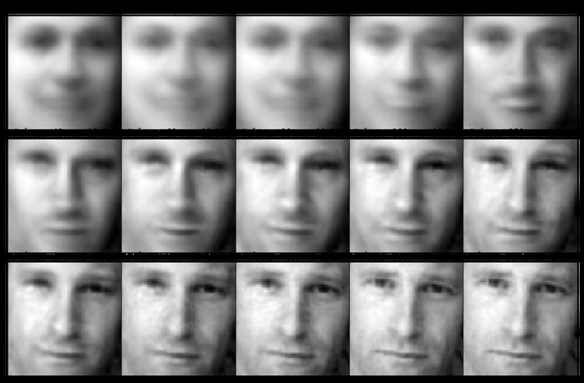
23 - Types of Dimension Reduction
The method we are going to cover in this class for dimensionality reduction is principal component analysis.
PCA is one kind of Factor Analysis, which also includes other methods for identifying factors.
Linear Discriminant Analysis is an analogue of Linear Regression that tries to find lines that split the data in useful ways, sort of “perpendicular” to the normal way that we find lines that explain our data.
A PCA technique using “eigenfaces” can simplify image data to recognize faces. While each of these components is not very facelike, they can be used to create very compressed summaries of facial information, to make it easier to identify individuals in a photograph.

Slide 30
Principal Components Analysis

Slide 31
24 - Principal Component Analysis
Principal Component Analysis (PCA) is a dimension-reduction tool that can be used to reduce a large set of variables to a small set that still contains most of the information in the large set.
PCA procedure transforms a number of (more-or-less) correlated variables into a (smaller) number of uncorrelated variables called principal components.
The first principal component will account for as much variablity as it can, and the second will capture information in a perpendicular or orthogonal direction, so that it has information unique from the first component.
This technique actually uses the matrix algebra idea of eigenvectors. Each component is actually an eigenvector, and its eigenvalue explains how much variation is captured by each component.

Slide 32
25 - Principal Component Analysis Example
We are using R’s USArrests data set, a data set from 1973 which showcases the following:
rate per 100,000 residents of murder
rate per 100,000 residents of rape
rate per 100,000 residents of assault
% of the population that is urban
The goal is to reduce the dimensionality (currently 4), while losing little or no information from the data.

Slide 33
26 - Principal Component Analysis Example
data("USArrests") head(USArrests)
Murder Assault UrbanPop Rape Alabama 13.2 236 58 21.2 Alaska 10.0 263 48 44.5 Arizona 8.1 294 80 31.0 Arkansas 8.8 190 50 19.5 California 9.0 276 91 40.6 Colorado 7.9 204 78 38.7

Slide 34
27 - Principal Component Analysis Example
What we notice is principal components 1 and 2 can explain 86.75% of the variation in the data sets. Here the cor=TRUE option is used to standardize the scale of each variable before computation—often necessary when different variable are measured in different units or on different scales.
pca_USArrests <- princomp(USArrests, cor=TRUE) summary(pca_USArrests)
Importance of components: Comp.1 Comp.2 Comp.3 Comp.4 Standard deviation 1.57488 0.99487 0.597129 0.416449 Proportion of Variance 0.62006 0.24744 0.089141 0.043358 Cumulative Proportion 0.62006 0.86750 0.956642 1.000000

Slide 35
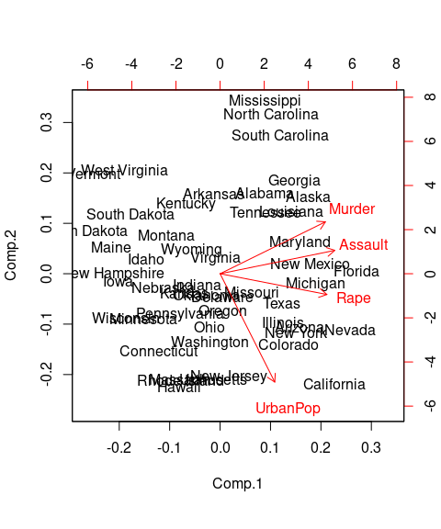
28 - Principal Component Analysis Example
The closeness of the murder, assault, and rape arrows indicates that these three types of crime are, intuitively, correlated.
head(pca_USArrests$scores)
Comp.1 Comp.2 Comp.3 Comp.4 Alabama 0.98557 1.13339 0.444269 0.1562671 Alaska 1.95014 1.07321 -2.040003 -0.4385834 Arizona 1.76316 -0.74596 -0.054781 -0.8346529 Arkansas -0.14142 1.11980 -0.114574 -0.1828109 California 2.52398 -1.54293 -0.598557 -0.3419965 Colorado 1.51456 -0.98756 -1.095007 0.0014649
biplot(pca_USArrests)

Slide 36
29 - Question
Facial biometric matching was one of the first applications to have used dimension reduction. Read the Wikipedia articles about Eigenfaces and answer the question. Scholarpedia has more math content, but may be of interest to some.
Eigenface (wikipedia.org)
Eigenfaces (scholarpedia.org)
What is true of Eigenfaces (check all that apply)?
The same technique used for eigenfaces can be used for either kinds of recognition—handwriting analysis, medical imaging, and voice recognition, to name a few.
A mean face is when a photographed subject is asked to look angry.
A newly introduced image of a face can be calculated as the sum of a set of calculated eigenfaces, each of which is a visual representation of a principal component.
Unlike in normal PCA, the first few eigenfaces are not very useful.

